Slide 1
Unpacking The Data From The Game Dataset
Hassan Aamir
453976
BSCS13D

Slide 2
How does performance vary with prestige?
Not all countries compete equally across all prestige levels. Each nation exhibits a distinct prestige profile, a strategic reflection of its unique capabilities and focus areas.

Slide 3
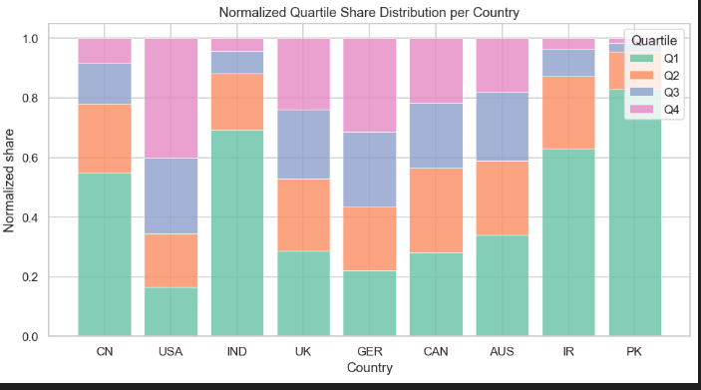
Each country has a prestige sweet spot, wherein they win more medals
We can see that Pakistan’s share of medals is highly concentrated in the lower prestige quartile – Quartile 1.

Slide 4
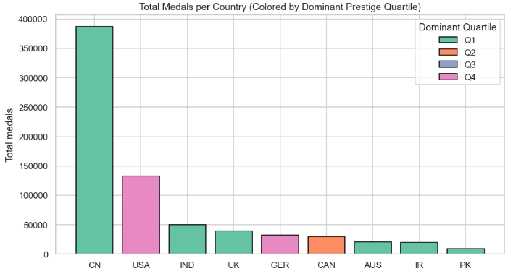
CN, who have the highest medals, have the highest share from lower prestige games – Q1
USA on 2nd have the highest share of medals from the highest prestige games – Q4
This shows the different strategies taken by each country

Slide 5
Group Structure and Prestige
Similarly, each group also performs differently according to the prestige level of the game. This reflects a particular strategy taken by a particular group, or their strengths in games that have a certain prestige score.

Slide 6
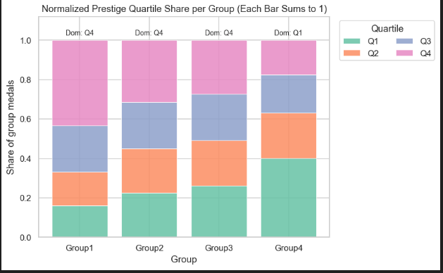
Group 1 to 3 have their share of model from quartile 4 of the prestige – higher prestige.
Group 4 has its larger share from quartile 1.
It is possible that PK and group 4 have similar liabilities making major of their medals from lower prestige games.

Slide 7
Strategic Position of Pakistan
We will see that Pakistan is getting its large share of medals in lower prestige games. This shows that either that is Pakistan’s strategy, or it has weakness preventing it from succeeding in higher prestige games

Slide 8
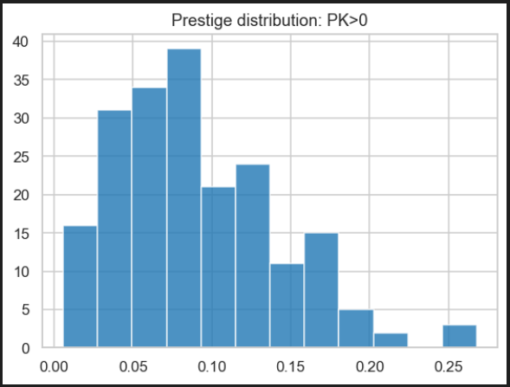
We clearly see that the medals won by PK are largely in the lower prestiege levels.
This shows Pakistan is either not interested in higher prestige games or lacks competitiveness in them.

Slide 9
THANK YOU

